Slide 1
Catastic Companions
Presented by: Arica Conrad
BIT 465 – REST API Development
March 16, 2022

Slide 2
What is My API?
My API is for a fictional cat shelter called Catastic Companions.
I imagined that this API would used at the shelter for internal use only, so it is not public-facing.
Catastic Companions keeps track of all the cats they have housed at their shelter, including the ones who have now been adopted.

Slide 3
API Design

Slide 4
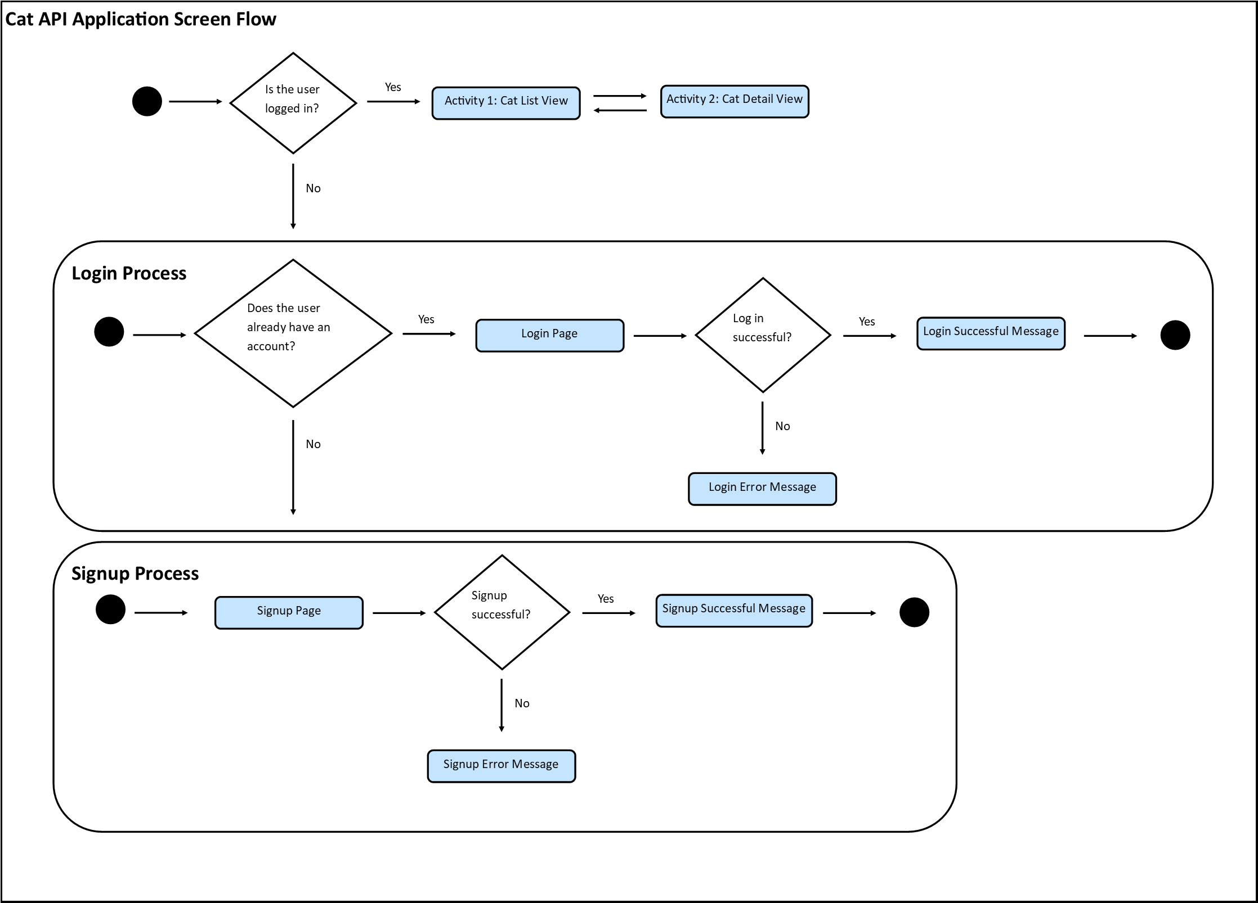
The Flow of the Application

Slide 5
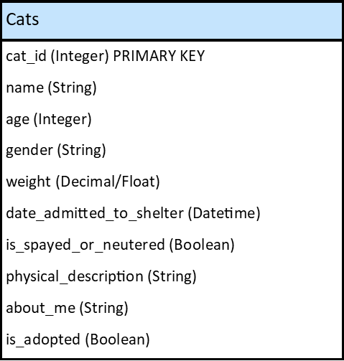
The Cats Table
* Last minute addition: photo(String/URLField)

Slide 6
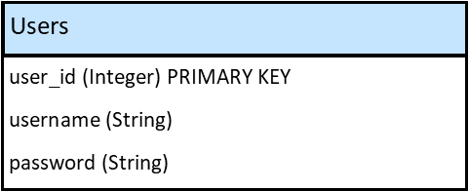
The Users Table
*At minimum (default Users has more fields)

Slide 7
API Implementation

Slide 8
Technologies Used
Framework: Django
Database: SQLite
Web Pages: Custom for login, Django Admin for Cats
GitHub: In progress

Slide 9
How Does the API Work?
Since this API is for internal use only, the shelter employees must log in to view the list of all the cats.
An employee (user) can sign up, log in, and log out.
The head of the shelter (the superuser) can see all the employees (users) and the cats, but the rest of the shelter employees can only see the cats.
All employees can see all the cats and view the details of one cat. They can create, edit, and delete a cat.

Slide 10
API Scenario

Slide 11
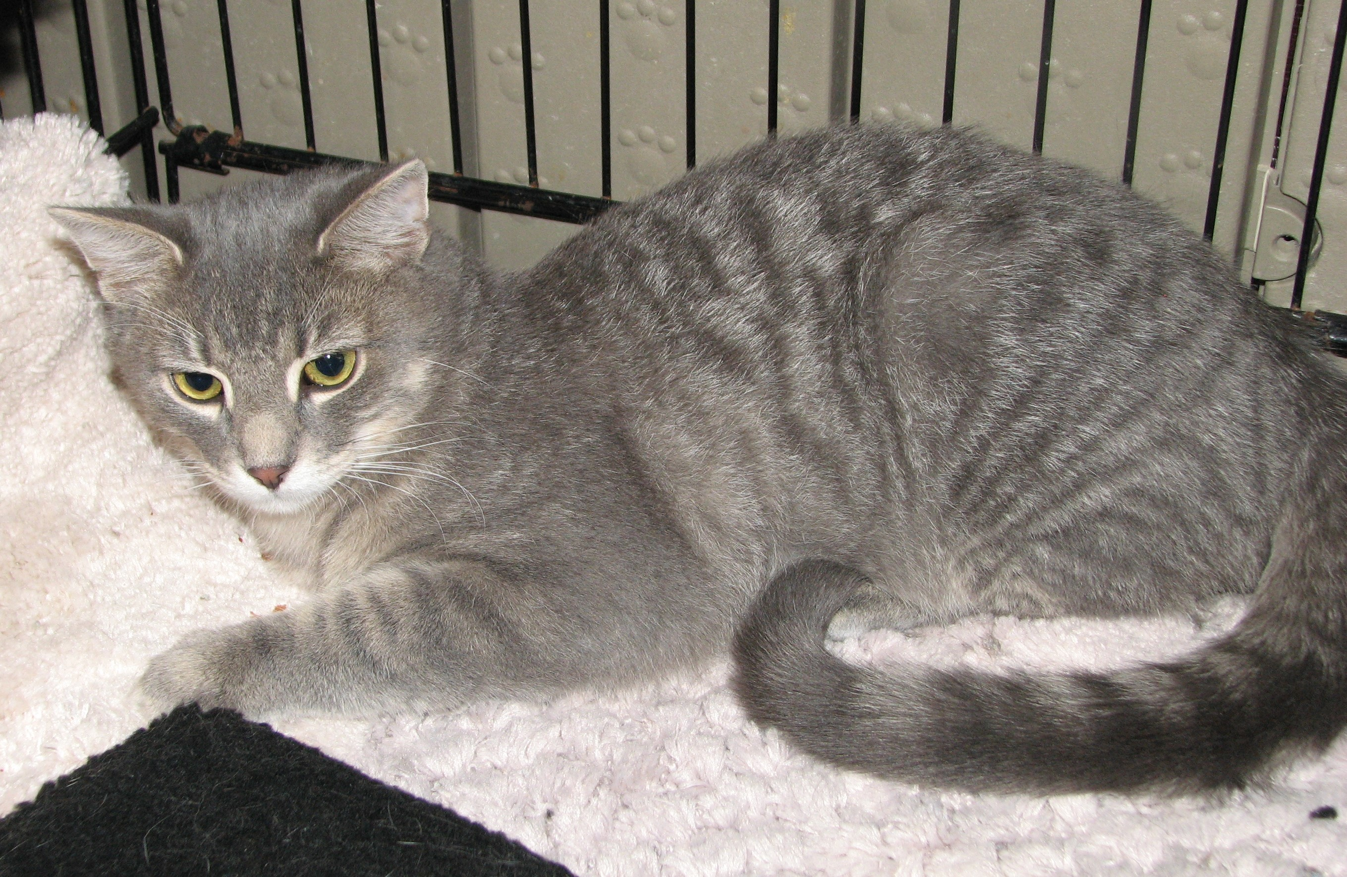
A New Cat Has Arrived…
Name: Buddy
Age: Unknown, estimated to be 12
Gender: Male
Weight: 9.25 (in pounds)
Date Admitted to Shelter: 2022-03-16
Neutered: False (Unknown)
Physical Description: Gray tabby male with yellow eyes.
About Me: Unknown, to be determined
Adopted: False
Photo: https://bit.ly/3wdZVPX

Slide 12
Adoption Day!
Name: Buddy
Age: 14
Gender: Male
Weight: 9.50 (in pounds)
Date Admitted to Shelter: 2022-03-16
Neutered: True
Physical Description: Gray tabby male with yellow eyes. Has some arthritis.
About Me: Buddy is a bit shy around strangers, but he is friendly with those he is familiar with. He likes to seek out sources of heat, including your empty lap.
Adopted: True
Photo: https://bit.ly/3wdZVPX

Slide 13
API Demo

